Slide 1

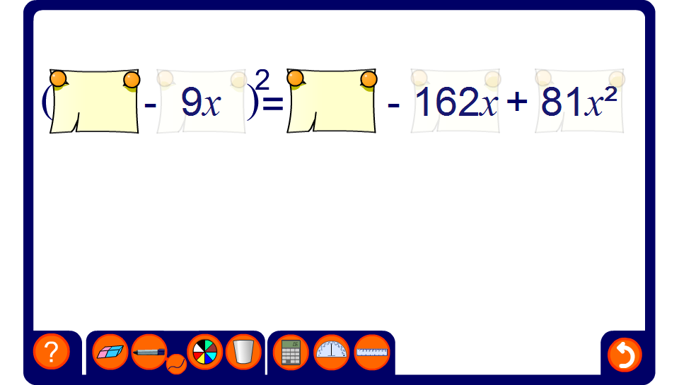


Squaring expressions
Notes:
Any of the terms in the expansion can be hidden or revealed to practice squaring expressions.

